Slide 1

TYPES OF INFORMATION
SYSTEMS

Slide 2

TYPES OF INFORMATION SYSTEMS
Transaction processing systems Management information system and decision support systems
Executive support system for senior management

Slide 3
Transaction processing system
Transaction processing system is a type of information system
. TPSs collect, store, modify and retrieve the transactions of an organization, A Transaction is an event that generates or modifies data that is eventually stored an information system.
E.g : Order entry system, cheque processing systems, accounts receivables systems, payroll systems and ticket reservation systems
These systems help any company to conduct operations and keep track of its activities

Slide 4
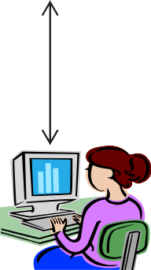
A PAYROLL TPS
To general ledger
EMPLOYEE DATA
Payroll System
Employee
/file database
Management reports
Employee number
Address Pa rate Gross pay
Federal tax Medicare State tax Net pay
To government
agencies
Employee paychecks
Online queries

Slide 5

TPS CHARACTERISTICS
A TPS records internal and external transactions for a company. It is a
repository of data that is frequently accessed by other systems
A TPS performs routine , repetitive tasks .It is mostly used by lower level managers to make operational decisions
Transactions can be recorded in batch mode or online.In batch mode the files are updated periodically.In online mode , each transaction is recorded as it occurs
There are six steps in processing a transaction.they are data entry
,data validation , data processing and revalidation , storage – output generation and query support

Slide 6
Objectives of TPS
Process data generated by and about transactions
Maintain a high degree of accuracy and integrity
Avoid processing fraudulent transactions
Produce timely user responses and reports
Increase labor efficiency
Help improve customer service
Help build and maintain customer loyalty
Achieve competitive advantage

Slide 7

TYPES OF TPS
Online system:
it involves a direct connection between the operator and TPS program , they provide immediate result eg . An order arrive by telephone call it is processed at that moment and results are produced
Batch processing:
it is the second type of TPS ,where transactions are grouped together and processed as a unit
for eg: a cheque proccesing system in a bank all the cheque received in a particular day are grouped together. They are then sorted by the account no and processed in a batch

Slide 8
More Examples
Batch transaction processing:
Cheque clearance :written order asking bank to pay money to a person
Bill generation : an invoice for general services provided to the customers
credit card sales transaction
Examples of real time transaction processing:
reservation systems; set aside service/product for future use point -of-sale (POS) terminals ;sells goods/services
library loan system ; keeps track of items borrowed from library

Slide 9
Difference between real time and
Batch
Real time:
each transaction is unique ; transactions are standlone; requires master file to be available more often for updating; fewer errors-transaction data is validated and entered immediately; infrequent errors may occur; not practical to shut down the whole system
Batch:
each transaction pat of a group; database not accessible all of the time; more errors; data is organized and stored before master file is updated -errors can occur during these steps; easier to maintain than real- time.

Slide 10
MIS
Designates a specific category of information systems
serving middle management.
Provides middle managers with reports on organization’s current performance.
Information thus obtained is used to monitor and control
and business and predict future

Slide 11
Characteristics of MIS
MIS is an integrative system
MIS is Sub System concept
Provides relevant information to management
MIS is flexible
Enhances productivity
Is a coordinated system
Feedback system

Slide 12
MIS
MIS
TPS
Order file
Order Processing system
Sales data
Production Master
file
 | Materials Resource Planning system
Unit Product Cost data
MIS
reports
Product change data
managers
Accounting
file
General Ledger system
Expense data

Slide 13
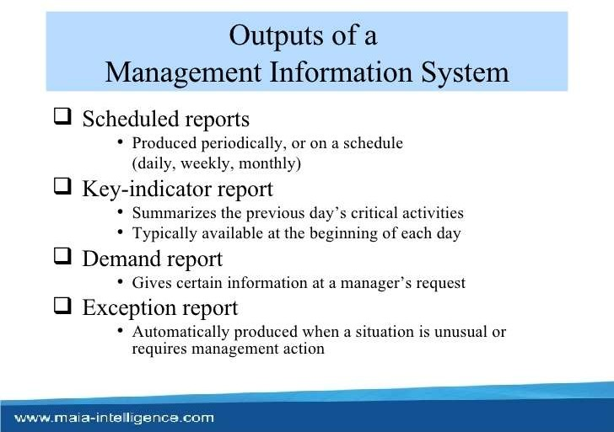

Slide 14
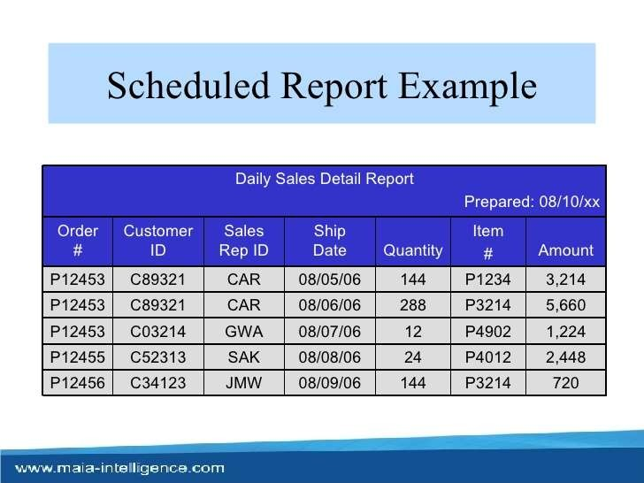

Slide 15
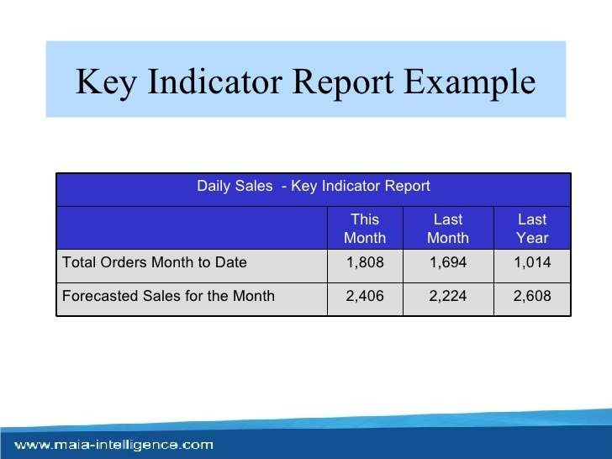

Slide 16
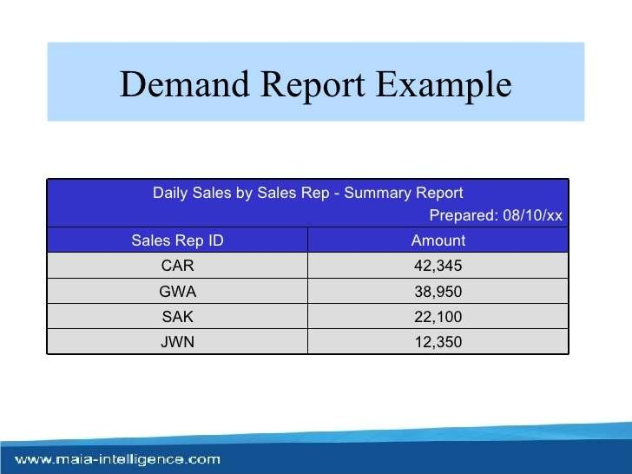

Slide 17
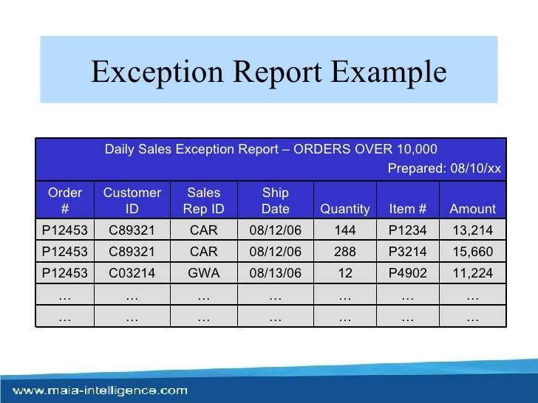

Slide 18

Decision Support System
A decision support system (DSS) is a computer program application that analyzes business data and presents it so that users can make business decisions more easily. It is an "informational application" (to distinguish it from an "operational application" that collects the data in the course of normal business operation).Typical information that a decision support application might gather and present would be:
Comparative sales figures between one week and the next
Projected revenue figures based on new product sales assumptions The consequences of different decision alternatives, given past experience in a context that is described
A decision support system may present information graphically and may include an expert system or artificial intelligence (AI). It may be aimed at business executives or some other group of Knowledge workers

Slide 19
Characteristics of Decision support system
Provides rapid access to information
Handles large amount of data from different sources Provides report and presentation flexibility
Offer both textual and graphical orientation
Support drill down analysis
Perform complex ,sophisticated analysis aqnd
comparisons using advanced s/w

Slide 20
Activities in decision support system
What if analysis Sensitivity analysis Goal seeking analysis Optimization analysis

Slide 21

VOYAGE-ESTIMATING DECISION SUPPORT SYSTEM
Ship file eg speed,capacity
PC
Port distance Restriction file
fuel consumption cost file
Ship charter hire history cost file
Analytical Models database
Port expense file
Online queries

Slide 22

DSS:Example
Voyage estimating system calculates financial and technical voyage details. It is based on analytical models.
Financial calculations include :
ship/time costs(fuel, labor, capital) ,freight rates for various types of cargo and port expenses
Technical details include factor as:
ship cargo capacity, speed ,port distances ,fuel and water consumption and loading patterns ( locations of cargo for different ports

Slide 23

cont
The system can answer questions such as:
Given a customer delivery schedule and an offered freight rate, which vessel should be assigned at what rate to maximize profits?
What is the optimal speed at which a particular vessel can optimize its profit and still meet its delivery schedule?
What is the optimal loading pattern for a ship bound for US west coast from Malaysia?

Slide 24
DSS : Intrawest(largest Ski operator in north America
The system is not not model driven , focusing instead on extracting useful information to support decision making from massive quantities of data.
It uses special software to analyze these data to determine the value , revenue potential and loyalty of each customer so managers can make better decisions on how to target their marketing programs
The system segments the customers into categories from “passionate experts” to “ value – minded family
vacationers “ etc
The company then emails video clips that would appeal to each segment to encourage more visits to its resort

Slide 25
EXECUTIVE SUPPORT SYSTEMS FOR SENIOR
MANAGEMENT
Issues at senior Management level:
What will employment be in 5 yrs ?
What are long term industry cost trends , where does our
firm fit in?
What products should we be making in next 5 yrs? What new acquisitions would protect us from cyclical business swings ?

Slide 26
Characteristics of ESS
Are tailored to individual executives Are easy to Use
Have drill down abilities
Support the need for the external data
Can help with situations that have high degree of uncertainty
Have a future orientation
Are linked with value added business processes

Slide 27
Role of ESS
Addresses non routine decision requiring judgement , evaluation, and insight
Presents graphs and data from many sources through an interface that is easy for senior managers to use
Incorporates data about external events such as new tax laws or competitors ,but also draws a summarized information from internal MIS and DSS
It filters ,compresses and track critical data , displaying that data of
greatest importance to senior managers.

Slide 28
MODEL OF AN EXECUTIVE SUPPORT SYSTEM
ESS
Workstation/Portal
Menus
Graphics
Communications
Digital Dashboards
ESS
Workstation/Portal
ESS
Workstation/Portal
Internal data
External data
TPS/MIS data Financial data Office systems Modelling/analysis
Dow Jones
Internet news feeds Standard & Poor
Menus
Graphics
Communications
Digital Dashboards
Menus
Graphics
Communications
Digital Dashboards

Slide 29

INFORMATION SYSTEMS FOR
BUSINESS FUNCTIONS

Slide 30
Marketing Information system
Marketing information system (MKIS) is a computer based system that works in conjunction with other functional
information systems to support the firm’s management in solving problems that relate to marketing of firms products.The role of (MKIS) is to assess
The marketing managers information needs
Develop the framework for collecting information and
distribute the information gathered to the end users in time
MIS generally carries out marketing need analysis,planning
, implementation and control functions of marketing
managers

Slide 31
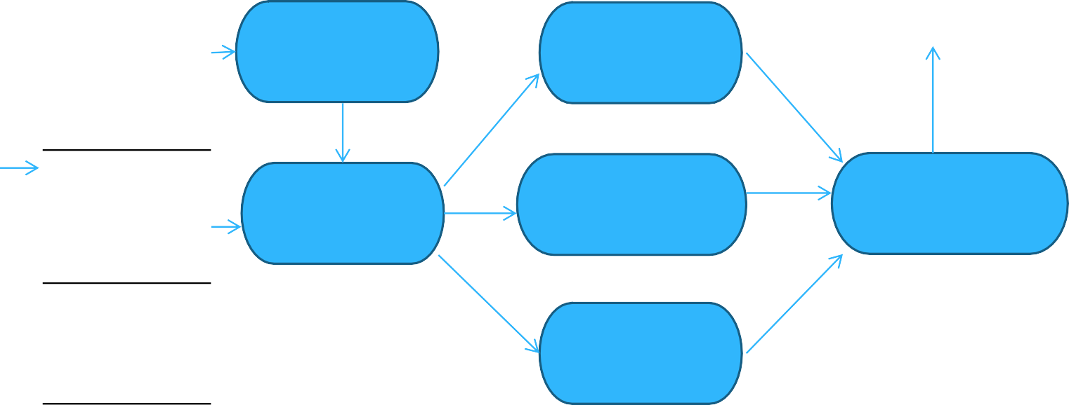
Marketing Information system
Data bank
Transaction Processing data
Other areas Of firm
Budget allocation
Place planning
Marketing Research data
Marketing Intelligence data
External
environment
Product planning
Promotional planning
Sales
forecasting
External Environment data
Price planning
Strategic plan

Slide 32
Input of marketing management systems
Transaction processing data
Marketing research data
Marketing intelligence data
External environment data
Strategic plan

Slide 33
Output of Marketing information system
Product planning Place planning Promotion
Price Budget Allocation
Sales forecast

Slide 34
Human resource Information System
The Human Resource Information System (HRIS) is a software or online solution for the data
entry, data tracking, and data information needs of the Human Resources, payroll, management, and accounting functions within a business.

Slide 35
he HRIS that most effectively serves companies tracks: Attendance and PTO use,
Pay raises and history,
Pay grades and positions held, Performance development plans, training received,
Disciplinary action received,
personal employee information, and occasionally, management and key employee succession plan, High potential employee identification, and applicant tracking, interviewing, and selection.

Slide 36
HRM Information Systems
HRM
Information Systems
Staffing
Training and developement
Compensation Administration
Strategic system | HR planning | Succession planning | Contract costing
 |  |  | salary forecasting
 | labour force tracking | performance Appraisal
Tactic system | Lobour cost budget | planning Training effectiveness | Compensation effectiveness
 |  |  | benefit preference analysis
 | Analysis turn over | Career matching
 | analysis
Operations system | recruiting | Skill assessment | Payroll control
 | work force planning/ | performance evaluation | Benefits Administration
 | scheduling

Slide 37

Accounting Information Systems
An Accounting Information System (AIS) is the system of records a business keeps to maintain its accounting system. This includes the purchase , sales , and other financial proceses of the business. The purpose of an AIS is to accumulate data and provide decision makers ( investors , creditors , and managers ) with information to make decisions.
Inputs
processes
outputs
Transaction data
Amendments to data
Accounting System
Financial statement Invoices
Receipts
Management information

Slide 38
AIS studies structuring and operation of planning and
control processes which are aimed at
Providing information for decision making and accountability to internal and external an stakeholder that complies with specified quality criteria
Providing the right condition for sound decision making
Ensuring that no assets illegitimately exit that organization

Slide 39
Types of Accounting IS
General ledger systems Asset Management Order-entry system
Account receivables and payable system Inventory control system
Payroll system
Cash management

Slide 40
Accounting Information Systems
The Accounting Information System (AIS) performs the firm’s accounting applications . A high volume of data processing characterizes these applications . Data processing consists of four major tasks – data gathering , data manipulation
, data storage , and document preparation
AIS is data oriented rather than information oriented , and the data is largely
historical
Although the AIS is data oriented, it does produce some information .In addition
, it provides the database that serves as the foundation for other CBIS subsystems

Slide 41
Financial Information System
The term Financial Information System is used to describe the CBIS subsystem
That provide information to persons and group both inside and outside the firm concerning the firm’s financial matters . Information is provide in the form of periodic reports , special reports , and results of mathematical simulation , electronic communication , and the advice of expert systems
A financial MIS provides financial information not only for executives but also for a broader set of people who need to make better decision on a daily basis. Financial MISs is used to streamline reports of transactions.

Slide 42
Features of financial Information system
User friendly interface Divisionalized reporting Consolidated reporting Modular structure Automatic interface Flexible account numbering G/L control accounts Flexible report formats Installation options Generative
security

Slide 43
Functions of financial IS
Most financial MIS’s perform the following functions:
Integrate financial and operational information from multiple sources including internet , into a single system
Provide easy access to data for both financial and non financial users
, often through the use of a corporate intranet to access corporate web pages of financial data and information
Make financial data immediately available to shorten analysis turnaround time
Enable analysis of financial data along multiple dimensions – time
,geography , product , plant and customer
Analyze historical and current financial activity Monitor and control the use of funds over time

Slide 44
Financial information system
Input subsystem
output subsystem
Internal audit
subsystem
Forecasting subsystem
Fund management subsystem
Financial intelligence
subsystem
Data
base
Control
subsystem
data
information

Slide 45
System Analysis and Design
The overall process by which information systems are designed and implement within organizations is referred to as System analysis and design ( SA &D).Within this process are contained activities that include idedentification of business problems ; the proposed solution , in the form of an information system (IS ) , to one or more of the problems identified ; and the design and implementation of that proposed solution to achieve the desired and stared goals of the organization

Slide 46
The system development life cycle
One of the methods of using the systems approach to develop information system solutions , and the most prevalent one in the organization system analysis and design , can be viewed as multistep
, iterative process called the systems development life cycle (SDLC)

Slide 47
Systems Investigation Product: Feasibility study
Determine how to address business opportunities and priorities
Conduct feasibility study to determine whether a new or
improved business is a feasible solution
Develop a project management plan and obtain management approval
Understand the business problem or opportunity
Analyze the information needs of employees , customers , and other business stakeholders
Develop the functional requirements of a system that can meet business priorities and need of all the stakeholders
Develop logical models of current system
System
Analysis Product: Functional requirement
Develop an Information system solution
Develop specifications for the hardware
, software, people, network , and data resources , and the information products that will satisfy the functional requirements of the proposed business information system
Develop logical models of new system
System
Design Product: System specifications
Acquire (or develop) hardware and software
Test the system , and train people to operate and use it
Convert to the new business system
Manage the effects of system changes on end users
Implement the information system solution
System
Implementation Product: Operational system
Use a post implementation review process to monitor , evaluate and modify the business system as needed
System Maintenance Product: Improved system

Slide 48
Feasibility study
Operational feasibility
how well the proposed system supports the business priorities of the organization
How well the proposed system will solve the identified problem
How well the proposed system will fit with the existing organizional
structure
Economic feasibility
Cost saving, increased revenue , decreased investment requirement, increased profit ,cost benefit analysis
Technical feasibility
Hardware ,software , and network capability ,reliability and availability
Human Factors Feasibility
Employee, customer ,supplier acceptance , management support
,determining the right people for the various new or revised roles
Legal/Political feasibility
Patent , copyright and licensing , government restrictions , affected stakeholders and reporting authority

Slide 49
Systems analysis
System analysis is not a preliminary study; however it is an in depth study of end user information needs that produces functional requirements that are used as the basis for the design of a new information system.System analysis traditionally involves a detailed study of:
The information needs of a company and endusers like yourself The activities , resources , and products of one or more of the present information system being used
The information system capabilitiesrequired to meet your information needs , and those of other business stakeholders that use the system

Slide 50

Important steps for System analysis
Organizational analysis Analysis of the present system Logical analysis
Functional requirement analysis and
determination

Slide 51
Examples of Functional requirement for
proposed e commerce system for a business
Examples of Functional requirements
USER FRIENDLY INTERFACE Automatic entry of product data and easy to use data entry screens for web customers
PROCESSING REQUIREMENTS Fast , automatic calculation of sales totals and shipping costs
STORAGE REQIREMENTS Fast retrieval and update of data from product , pricing and customer data base
CONTROL REQUIREMENTS Signals for data entry errors and quick email confirmation for customers

Slide 52
Eg of the functional requirements for the
proposed e commerce system
User interface requirement
Automatic entry of product data and easy to use data entry screens for web consumers
Processing requirement
Fast, automatic calculation of sales totals and shipping costs
Storage requirements
fast retrieval and update of data from product , pricing , and customer daabases
Control requirements
Signals for data entry errors and quick email conformation for customers

Slide 53
System design
Once the analysis portion of the life cycle is complete , the process of system design can begin . here is where the logical model of the current system is modified until it represents the blueprint for the new system.
Focus is on how the system will accomplish its objectives. This is where issues related to hardware , software
, networking , data storage , security , and many others will be discussed and determined .
As such system design consists of design activities that ultimately produce physical system specifications satisfying the functional requirements that were developed in the system analysis process.

Slide 54
System design
System Design
User interface design
Data design
Process design
Screens ,Form
, Report, and dialog design
Data element Structure design
Program and Procedure design

Slide 55



Useful guideline for the design of business web sites
Remember the customers
Successful web sites are built solely for the customers, not to make company VP happy
Aesthetics
Successful designs combine fast loading graphics and simple color palettes
for pages that are easy to read
Easy to navigate
Make sure it’s easy to et from one part of your site to another. Providing a site map , accessible from every page
Searchability
Many sites have their own search engines , very few are actaully
useful.make sure yours is
Incompatibilities
A site that looks great on a PC using IE can often look miserable on an Ibook running Netscape
Registartion forms
Registration forms are a useful way to gather customer data.But make your
customers fill out three page form and watch them flee
Dead links
Dead links are the bane of all web surfers – be sure to keep your links up dated.many web design s/w tolls can now do tis for you

Slide 56
System Implementation
The system implementation stage involves hardware and software acquisition , software development , testing of programs and procedures , conversion of data resources , and a variety of conversion alternatives.
It also involves the education and training of end users and specialists who will operate a new system.
Implementation can be difficult and time consuming process , however it is vital in ensuring the success of any newly developed system .Even a well designed system will fail if it not properly implemented which is why the implementation process typically requires a project management effort on part of IT and business unit managers

Slide 57
Evaluating hardware, software, and services
Hardware Evaluation factors | Ratings
PERFORMANCE: What is its speed, capacity and throughput
COST : What is its lease or purchase price ? What will be its cost of operation and maintenance ?
RELIABILITY ; What are the risk of malfunction and its maintenance requirements? What are its error control and diagnostic features?
COMPATIBILITY : Is it compatible with existing hardware and software? Is it compatible with hardware and software provided by competing suppliers?
TECHNOLOGY:does it used a new untested technology , or does it run the risk of obolescence?
ERGONOMICS:Has it been “human factors engineered” with the user in mind ?Is it user friendly,designed to be safe , comfortable , and easy to use? | en
CONNECTIVITY:Can itbe easily connected to wide area and local area networks that use the different types of network technologies and bandwidth altenatives
SCALALBILITY:Can it handle the processing demand of a wide range of end users ,transactions , queries , and other information processing requirements ?
SOFTWARE: Are system and application software available that can best use this hardware?
SUPPORT:ARE the services required to support and maintain it available?
OVERALL RATING

Slide 58
Software Evaluation factors
Software Evaluation factors | Ratings
QUALITY : Is it bug free , or does it have many errors in its program code
EFFICIENCY: Is the software , a well developed system of program code that does not use much CPU time , memory capacity , or disk space?
FLEXIBILITY: Can it handle our business processes easily , without major modifications?
SECURITY: Does it provide control procedures for errors, malfunctions , and improper use?
CONNECTIVITY:Is it web enabled so it can easily access the Internet , intranet , and etranets , on its own , or by working with WEB browsers or other network software?
MAINTENANCE:Will new features and bug fixes be easily implemented by our software developers?
DOCUMENTATION:is the software well documented ? Does it include help screens and helpful software agents?
HARDWARE:Does existing hardware have the features required to best use this software?
OTHER FACTORS: What are its performance costs, reliablility , availibility, compatibility,modulaity ,technology ,ergonomics , scalability and support characteristics ?
OVERALL RATINGS

Slide 59
Evaluation factors for IS Services
Evaluation factors for IS Services | Rating
PERFORMANCE: What has been their past performance in view of their past promises
SYSTEMS DEVELOPMENT: Are Web site and other e- business developers available? What are their quality and cost ?
MAINTENANCE: Is equipment maintenance provided ? What are its quality and cost?
CONVERSION : What system development and installation services will they provide during the conversion period?
TRAINING: Is the necessary training of personal provided? What are its qality and cost/
BACK UP: Are similar computer facilities available nearby for emergency backup purpose?
ACCESSIBILITY : Does the vendor provide local or regional sites that offers sales , systems development , and hardware maintenance services? Is a customer support center at the vendor’s Web site available? Is a customer hotline provided?
BUSINESS POSITION:Is the vendor financially strong , with good industry market prospects?
HARDWARE: Do they provide a wide selection of compatible hardware devices an accessories?
SOFTWARE : Do they offer a variety of e business software and application packages

Slide 60
Other Implementation activities
Testing
Data conversion Documentation
Training
System conversion Post implementation

Slide 61
System maintenance

